Slide 1
HKEX Chatbook
Insights via data
Edition 1, June 2023

Slide 2
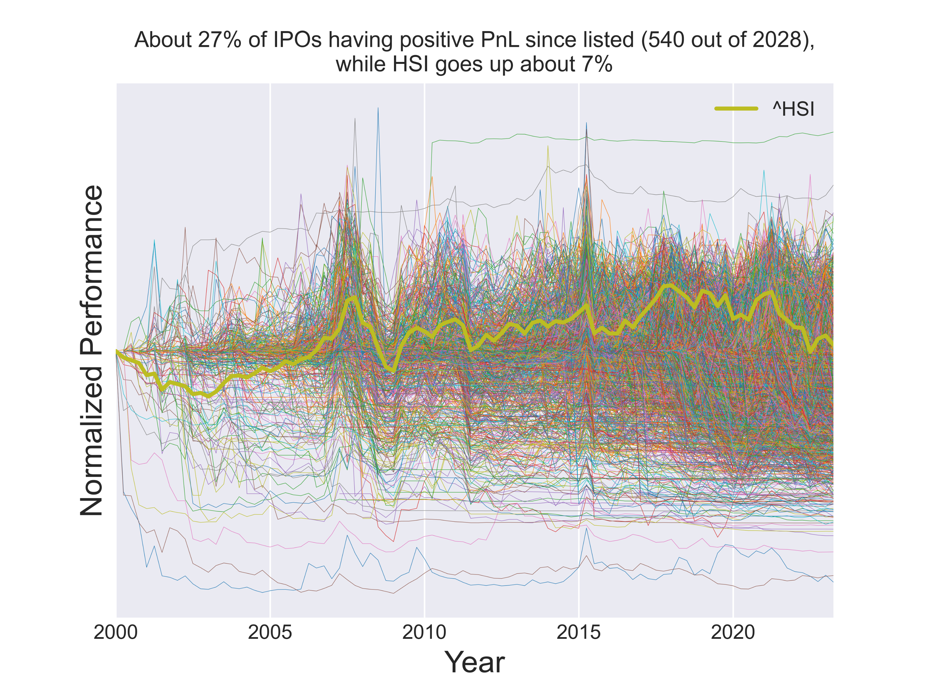
Do investors make money on HK stocks?
Looking at about all 2,000 IPOs since 2000 at HKEX
Source: hkex.com.hk and Yahoo finance from Jan 2000

Slide 3
Do investors make money on HK stocks?
If invested in the market on any day in the past 20 years, how the IRR would be like:
Source: Yahoo finance from Jan 2000

Slide 4
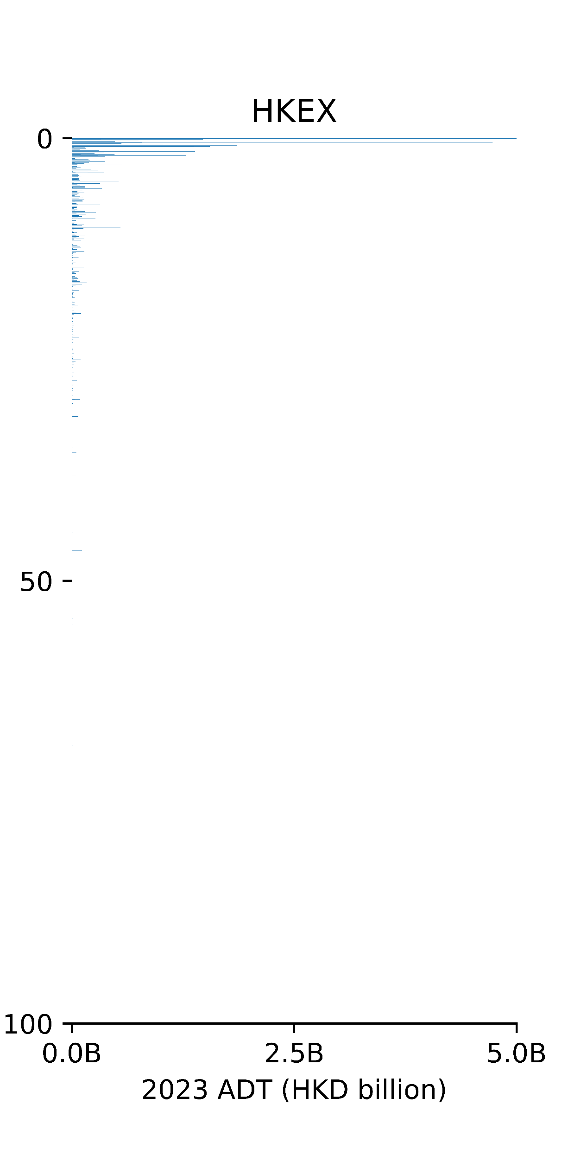
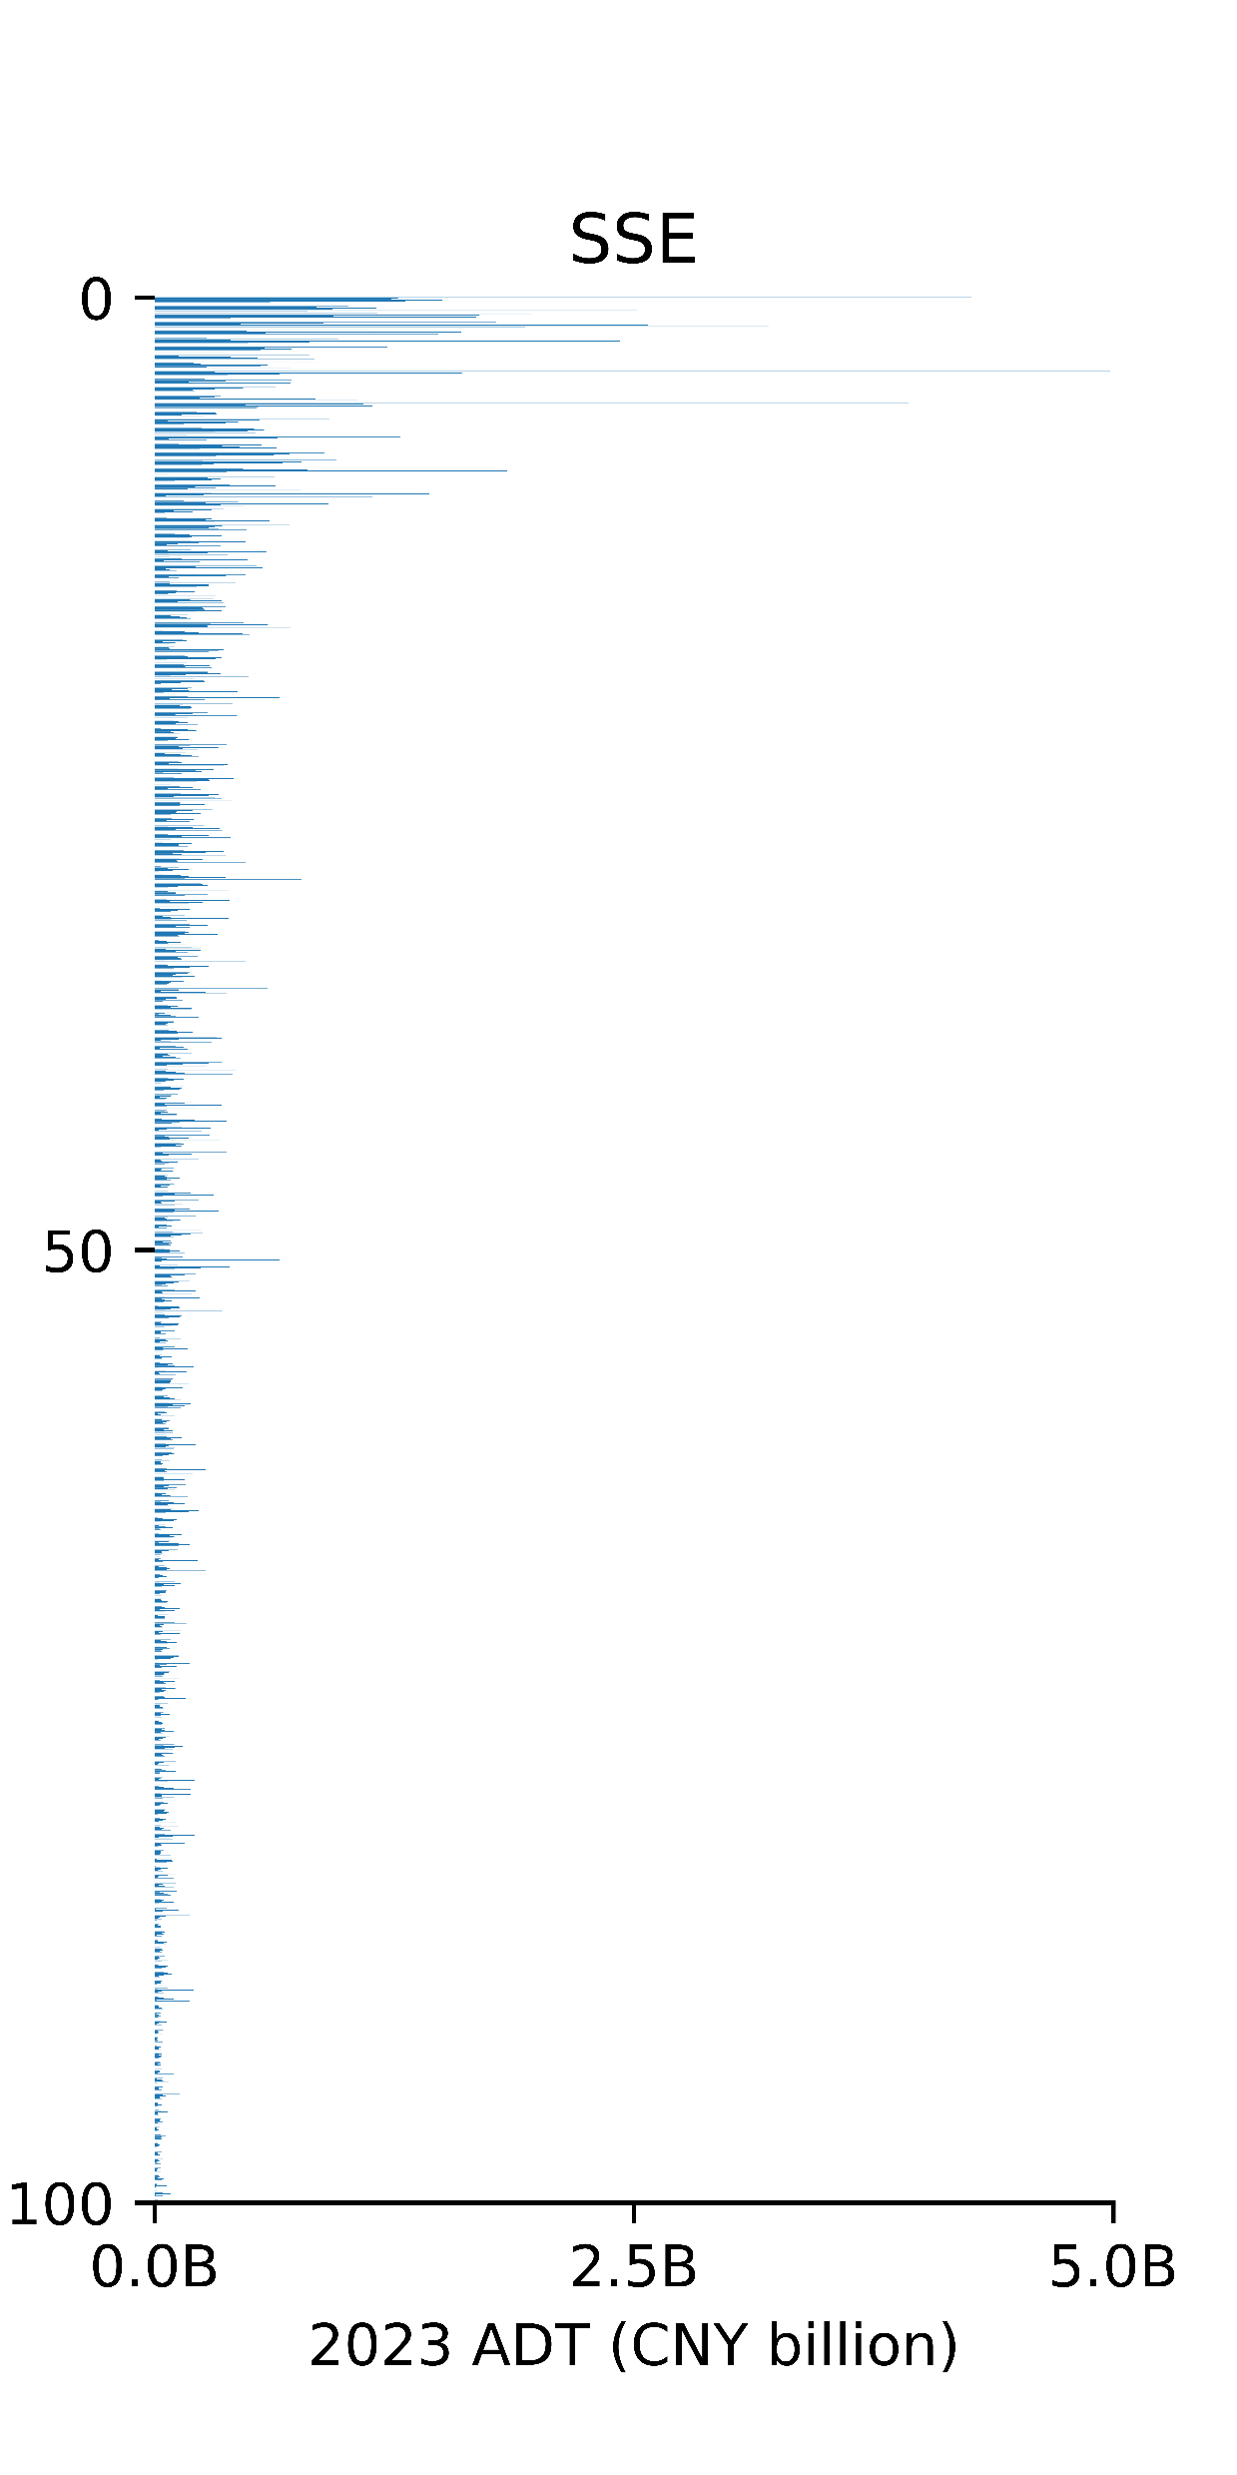
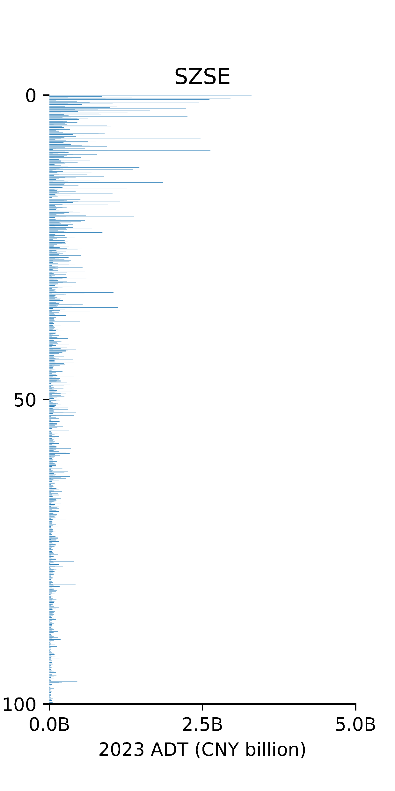
Is our market liquid?
ADT distribution by percentile of Market Cap
10%
20%
30%
40%
50%
60%
70%
80%
90%
100%
Source: Yahoo finance for 6-mth period from Jan 2023 to Jun 2023, incl. all main, GEM, STAR and ChiNext stocks

